Slide 1


Mescal-J6 Fire District
Strategic Plan Update 2026

Slide 2
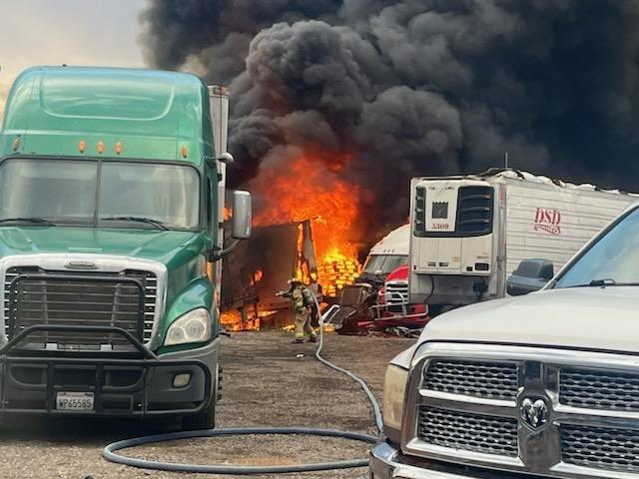
Review: What is Strategic Planning?
The Core Process:
The process of an organization deciding their direction, objectives and priorities, and then aligning their resources to accomplish the actions necessary to meeting them.
Strategic planning is the process of documenting and establishing a direction for your organization – by assessing both where you are and where you’re going.

Slide 3
Benefits of a Comprehensive Strategic Plan
Provides future direction for members and the community.
Ability to make decisions based on forecasted issues that directly affect the district.
The opportunity to solve major district problems.
Chance to discover currently unknown issues, internal and external.
Using a community-based approach, build credibility with external and internal stakeholders.
Helps keep the district from making reactive decisions to making proactive decisions.
Improve overall district performance.
Develop a coherent and defensible basis for decision making.
Develop a budget that is based on the strategic plan.

Slide 4
What were our mandates?
During the Strategic Plan Process both Internal and External Stakeholders were surveyed as to their expectations. This led the Internal Stakeholder Committee to take these expectations, combine them with the categories created and come up with our 6 Pillars or major areas.
We will proceed in order as the final Strategic Plan lines-out. We’ll explain what has been done to meet these community expectations.
"
"

Slide 5
Strategic Focus Area #1
Sustainability
Ensure long-term financial stability that maintains current service levels and when the community desires, provides for improvement in emergency and nonemergency services.

Slide 6


1A: Financial Stability & Budgeting
1A.1 External Stakeholder Communication Plan
1A.2 Multi-Year Budget Plan
Goal: Identify needed additional revenue
Goal: Inform community of district value & costs
How’d we do? Because of the mandatory AG form and 5-yr plan that is filled out annually, we feel we are at least in the ballpark as far as this goal. The best way to go about this is to create 10-year and capital plans. It is my hope we can accomplish this
Additional revenue could include annexation, wildland, and we will continue our current billing for services.
How’d we do? Between the Board Minutes, Chief’s Note’s, FB, Website, we feel we’ve done pretty good at bringing timely information,, but it’s my hope to bring a bit more concrete data points forward. Getting the FP&S grant will assist with this as it is data-driven. The budget is a reflection of these costs.
Notes:
Example of FD “worth”. House fire where saved 90% of structure, allowing for rebuild. Saved ~$100,000 of property, not to mention intangibles of heirlooms, pics, etc.

Slide 7


1A: Annexation & Cost Efficiencies
1A.3 Annexation Opportunities
1A.5 Cost Efficiencies
How’d we do? Not much has occurred in this area. However, this remains a viable option to bring in additional funding. We have some preliminary lines drawn for the areas we will explore. We are going to respond whether a residence is in or out of district as they are part of our agreed upon response areas, however, this takes tax-paying residents’ apparatus and FF out to someone who has not contributed. This I believe is first an education piece.
In just the last week, we’ve worked on annexation paperwork that will assist those wishing to be annexed into the Fire District. We hope to have an easy button on the website, but we’ll have to see if that will work yet. We are following docs of other districts who have this already in place in Pima County.
How’d we do? This area was one where we made some good progress. For example:
Deleted Board tablets from monthly phone bill—saving dollars.
Switched media/IT companies—saving money overall
Switched insurance companies—received much better coverage and saved money.
Agreement with BlueSpan for placement on our tower for free fiber optic/microwave Internet, allowing us to cx Starlink and save quite a bit.
BlueSpan has also agreed to place our repeater up on TEP tower for free, a savings of thousands of dollars.
Grants have also played a big role so we don’t have to reach into Reserve Account.

Slide 8
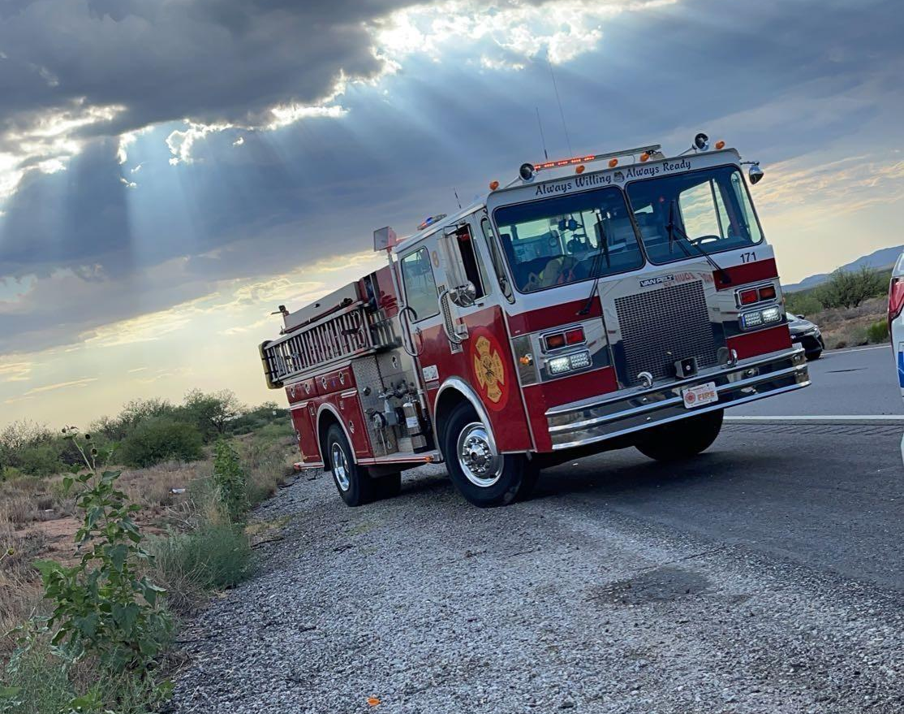
1A.4 Grant Opportunities (Part 1)
How’d we do? We have excelled in this area. It has been my goal as FC to do all I can through grants.
GOHS grant for $30,000 for new battery powered extrication devices
Church grant for $3500 for new AED’s
CDS/HRSA grant for $650,000 for new rescue vehicles with ALS, and special rescue equipment in process.
$3000 county grant for hose/nozzles
$8000+ Ak-Chin Tribal grant for turnout extractor
$3500 grant from DFFM for wildland gear
$2500 grant from Rescue me Wellness for FF physicals
Helipad upgrade through SSVEC $10,000 plus a generous $5,000 from Arizona G&T
$5000 grant for cancer screening
$17.625 from 100 Club for three complete turnout ensembles

Slide 9
1A.4 Grant Opportunities (Part 2)
Donations Secured
Grants Still in Play
Donated Connex box to place turnouts in and get them out of diesel exhaust
AFG for $37,000 in structural fire gear
FP&S for conducting Community Risk Assessment
Donated hose/nozzles/lighting from Sierra Vista FD
CDS/HRSA for rescue vehicles- passed initial test
Donated Type VI Brush Truck
CDS for $5M for new fire station
Donated Type III Wildland Truck
GOHS $17,000 for extrication stabilization for large vehicles such as semis.
Donated thousands of dollars worth of wildland equipment
Looking to Gary Sinese Foundation if above are not successful
Potential donated hundreds to thousands of dollars from Pima County Wildland Division-still waiting on this.

Slide 10
1A: Revenue & Shared Services
1A.6 Property Taxes
1A.7 Shared Services & Staff
How’d we do? We explored where our district sits with regard to other fire districts and found we were towards the bottom of mill rates. Subsequent to this, we initiated tax increases at (.08)/100 of assessed value, which has brought added income to the district, but it pales in comparison with the national inflation rate of over 4%, so we continue to do more with less and attempt to give our FF the necessary PPE, tools and equipment to do the job safely and efficiently.
How’d we do? We have a mutual aid program with our neighboring districts/departments. We also signed the Statewide Mutual Aid Compact. which means we will get or give help as we need/can during major incidents.
After we received our extrication equipment, we trained our personnel on it. Now we will begin holding extrication class/drills with Captain Olander teaching for our mutual aid partners. We will be having them utilize their equipment, but they will get some time on ours so they can see the difference.
It is my hope we can enter into an agreement for purchasing items that we all need together, looking for efficiencies.

Slide 11
Strategic Focus Area #2
Staffing
Ensure adequate staffing to meet the district’s mission throughout the period of the strategic plan.

Slide 12
2A.1 Determine Staffing Needs
Shift to 24/7/365 Coverage
Promotions & Reserve System
How’d we do? During the first part of the plan, we worked out a schedule where there was someone in-station ready to respond 24/7. This however required mandatory OT. This was not a long-term solution and so this FY year we added the 3rd FT FF. This is a FF health and safety issue, including mental health. Now our FF get the required amount of time off to then prepare for their next tour of duty.
We recently promoted one FF to Lieutenant due to the amount of work that needs completed. This individual will assist the Capt with administrative duties, thus eventually reducing the Capt’s workload a bit which should then reduce OT.
Our reserve system is working well We have individual FF come in for an 8-hour shift. This allows for experience running calls and education/training by our LTs and Capt.
It also helps as they help cover our busiest times, which statistically are 8-4
The FF, along with the addition of the Capt both on and off-duty and the Chief, respond as a team to ensure adequate coverage for certain high acuity calls. The Capt “floats” his time between shifts to ensure proper education, drilling, and station work are completed.

Slide 13
2A: Obstacles & Shared Staffing
2A.2 Identify Obstacles
2A.3 Shared Staffing Opportunities
How’d we do? The obstacles identified were overcome as we were able to hire strong, certified FF and EMTs. We were able to offer minor benefits, a comparable pay schedule, and an environment that people can “afford” to work here and because of our reputation, “want” to work here.
How’d we do?
I have brought up improving our SOG’s and SOPs as it pertains to response to the other Chiefs. Chief Spangler is working with Benson Dispatch on response models, so we have everyone dispatched at the same time automatically on certain call types, reducing overall response times.
We currently have the strongest cadre of first responders the district has ever had.

Slide 14
2B: Attract and Hire Qualified Personnel
Attracting the Best
2B.1 - 2B.6 Recruitment Program
How’d we do? We have had tremendous success when it comes to the quality of personnel that apply at MJFD. We believe our reputation has everything to do with it, and I can confirm that as when I do the very initial screening of individuals, almost all state that our reputation is the reason they want to be part of MJFD.
Objectives Overview: Identify current methods, analyze other organizations, gain input from current members, explore cadet programs, revise recruitment, and evaluate.
How’d we do? As stated prior, we have not had an issue with recruiting the best. However, this area will potentially get more attention in the upcoming year..

Slide 15

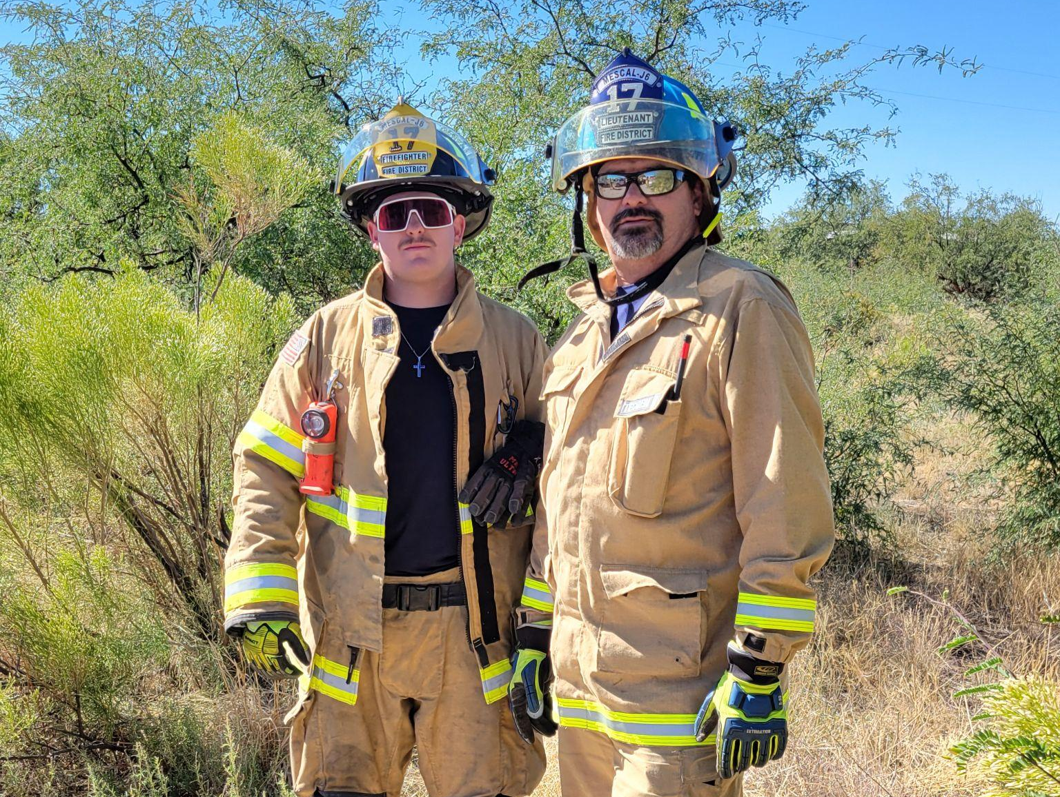
2C: Retain Personnel
2C.1 Foster a positive and fulfilling work environment.
How’d we do? This is an area MJFD excels at. The Capt, I. and the rest of the team including the Board set a very positive, results-oriented environment where employees find support, encouragement, discipline when warranted that is fair and consistent, and a very fulfilling work environment.
Happier FFs stay, this leads to consistency which is huge when your under-staffed.
Happier FF are safer, which assists with keeping injuries and illness down. People MUST be able to afford to work here. We’ve made great strides in this area.

Slide 16
2C: Wages & Benefits
2C.2 Biennial Wage/Benefit Survey
2C.3 Wage/Benefit Adjustments
How’d we do? Although no “formal” survey was conducted, MJFD did conduct informal discussions with other districts and departments.
How’d we do? Our pay scale and benefits are still below what some other districts offer, so we will continue to progress in this area as able. We have a choice of eye or dental insurance that is inexpensive and has already paid dividends to those who have used it We also, through our insurance company, provide accidental death/disability insurance as well as mental health coverage. We were able to enhance our pay schedule this year for our full-timers, Reserves and staff.
Based on our findings, we created a payroll schedule that is at least comparable with other dist/dept. We cannot yet enter the area of retirement systems as we must have 5 FT employees to do so. We will be looking at alternatives to this for potential inclusion into next year’s budget.

Slide 17
2C: Member Development
2C.4 Personal Development Needs
2C.5 Annual Individual Interviews
How’d we do? The Capt has been certified as a Fire Investigator I. He has recently completed the Fire Officer I and II course. One Lieutenant completed Fire Instructor I and the Fire Officer I & II training. Our PM and Capt attended a Community Risk Reduction 2-day course. Our media Specialist is now a certified Fire Prevention Officer.
Most of our FF have completed FF I & II, hazmat ops, WL, and rope ops certification and have completed advanced extrication training as well.
We will be sending 4 personnel on scholarship to the annual Arizona State Fire School for Ropes Technician training.
How’d we do? This is done at the time of each personnel’s annual evaluation and more informally as we talk about accomplishments.
Because I spend so much time at the station and the Capt and I speak about this regularly, we feel we are pretty much on top of it. I have been told by our personnel that I have created a very open line of communication and a willingness to hear their feedback. That is exactly what I want.
.

Slide 18
Strategic Focus Area #3
Operational Readiness

Slide 19
3A & 3B: Readiness & Partnerships
3A.1—3A.4 Readiness Policies & Procedures
3B Optimize Public & Private Partnerships
How’d we do? This is an area that needs updating. Some items are currently being worked on by Capt and Lt as they make their way through their FOI/FOII certification course.
How’d we do? The Chiefs are in fairly regular conversation. Our local mutual aid is pretty seamless, however, more needs done in this area as it pertains to SOGs and drilling. We have signed the Statewide Mutual Aid Compact.
I have worked out a system with the Chief of Benson FD, to adequately inform either the City Manager or Board Chair of times one of us is acting in a “Command” position for the other. Formal policy should be done.
We have teamed with the BLM and DFFM for WL PPE, a Type VI brush truck and now a Type III wildland truck. Our Chairman of the MJFD Board has donated thousands of dollars in equipment. Currently working with Pima County Wildland to outfit the rest of the items missing on our TypVI or III., as well as education components for residents.
Actively working on donation pathway for district.

Slide 20
3B: Water Supply & Mutual Aid
3B.1 Fire Suppression Water Supply Plan
3B.2 Formalize Mutual Aid Agreements
How’d we do? This area needs attention. We work very well together on scenes, however, standard SOG’s across the four districts would be better.
How’d we do? We secured access to a 55,000 gal water source, so it’s a good beginning.
We were initially given 3 tanks to inspect as to whether or not they would be connectable. This did not pan out as they were too far back on a property to access, or in a county owned easement, and some would be very expensive to outfit. There is also the strong probability that Hope Water will be putting a hydrant in at the Dollar General. This would save a mile or so of travel. More needs done in this area and we are hopeful we can get Pima County to assist in some way.
I have spoken with the other Chiefs and they are amenable to it. We just have to find room in busy schedules. After the standardization of our SOG’s, is the training that will need to occur with our mutual aid partners. I am hopeful this can be worked on in FY2027.
And, once again we have signed the SMAC

Slide 21
3B: Radio Reception & Call Processing
3B.3 Improve Radio Reception
3B.4 Call Processing Time Improvement
How’d we do? We have secured email confirmation that TEP and AZ Land have agreed to allow us to place our repeater on the TEP tower. This is huge for us. Our current radios do not hit our or any tower as we work on I-10 west and as the dip to Benson occurs. This will eliminate we estimate 90% of our lack of being able to get out with a handheld.
I’ve also, been informed that Benson Dispatch is upgrading their equipment. Between both items we believe our current issues will be at least reduced.
As far as the issues regarding the “bouncing” of calls between Pima County and SEACOM, we are attempting to work on this for a solid solution.
How’d we do? We are dispatched by Benson PD. The majority of the time they receive the call from SEACOM. We need to iron out how we can reduce or eliminate errors. Also, NCE has stood up their own dispatch, so we have three systems doing the best they can.

Slide 22
3C: Apparatus & Equipment Resources
3C Ensure Sufficient Apparatus
3C.1 Evaluate Current Apparatus
How’d we do? At the beginning of FY25, we had a tremendous lack of apparatus readiness. Lack of maintenance placed nearly every apparatus in a less than reliable place. This led to an increase in costing to fix the issues on every truck. This will continue to be an issue due to age of apparatus and storing them outside in elements, however, we are much more in a place of maintenance than repair.
We have secured the two WL trucks and are awaiting decision to order the new PU trucks, and UTV.
We cannot take delivery of a grant-purchased large apparatus such as an engine or tender until we have a new station with the mandatory conditions.
How’d we do? Our apparatus are all “timed” out according to NFPA Standards. Our reserve engine is not allowed to be used because it is an open cab. Our two tenders are past date as well. Our primary rescue vehicle and command vehicles are way past their useful life. As explained, we’ve done some good, but much more will be needed to ensure better reliability and operational readiness as it pertains to apparatus.

Slide 23
3C: Replacements & Maintenance
3C.2 Needed Replacement Apparatus
3C.3 Enhance Maintenance Program
How’d we do? We have identified the need for a primary Type I/III combo... capable to get to our residents where the road conditions are poor at best and be better able to respond during flooding as it would have 4x4 capabilities.
How’d we do? Every piece of equipment that has been or will be donated or purchased since 8/2024 meets or exceeds national standards. We have kept up on the maintaining of our apparatus so small problems don’t turn large. Our crews, during daily truck checks, have found small issues that although expensive at times, would save from catastrophic incident.
I am always looking at used fire apparatus,, however, we cannot write a grant for used trucks.
We have submitted our $650,000 HRSA grant for two primary rescue trucks. In addition, we will be receiving an UTV that will allow us to get “over the tracks” better and back even deeper into the off-road responses.. This will assist with the “Golden Hour” of trauma or medical issues.

Slide 24
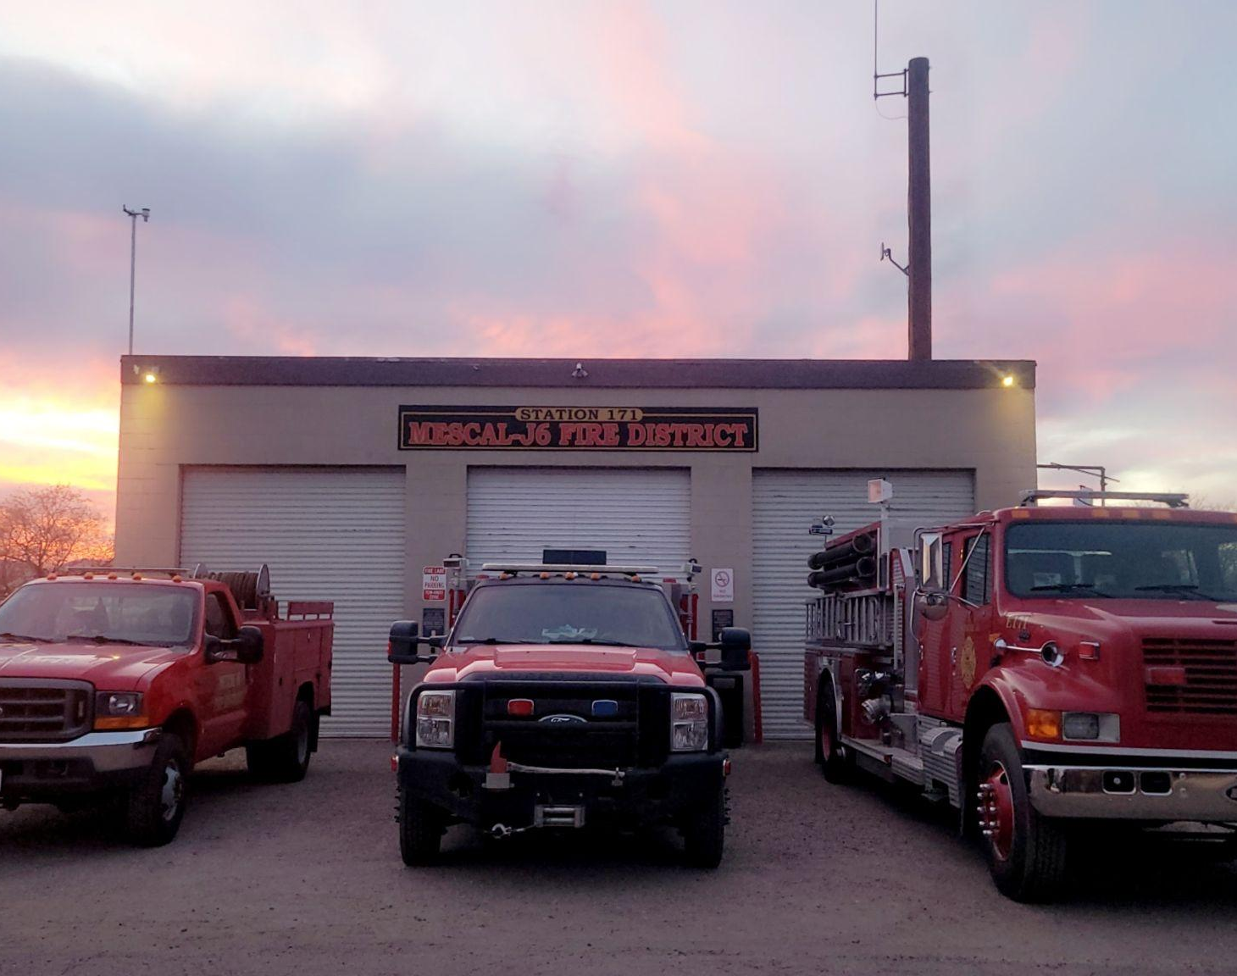
3D: Facilities Assessment
Ensure Mescal-J6 facilities are sufficient, functional and compliant.
Our current facilities will never come into compliance with code, NFPA standards, or OSHA law. They are simply too old and unrepairable. The only way we come into compliance is to build a new fire station. We MUST secure land and be shovel ready to accept funding.
Formal Assessment (Shive-Hatterly and Perlman): These two separate firms, who design and build fire stations, did independent assessments and came to the same conclusion: we cannot build a station on any piece of property that the District owns.
We are NOT talking a Taj Mahal, we are speaking to a modest, yet functional and safe station that will serve the community well into the future..

Slide 25
Strategic Focus Areas #4 & #5
Communication & Risk Reduction

Slide 26
4A & 4B: Internal & External Communication
4.A Improve Internal Stakeholder Comm
4.B Consistent Community Messages
How’d we do? Probably the number one way our community receives information is through our FaceBook site. We are continuing to utilize NextDoor to advise of any potential risks to the community. Our website is always looking to improve.
How’d we do? We feel that between my station visits, asking our personnel what they think about things, and then finding the gems that we have with innate talents has worked tremendously. Between shift change, email, website, Fire Chat, and FB we do have multiple ways for employees to engage both Lts, Capt and myself. I feel that our employees can be frank as they bring up issues or questions. We will always continue to try and improve based on employee feedback.
I would like to create an External Communications Committee with members of both the District, service area, Bd and FF on it to make recommendations as to how to improve them. We must also ensure compliance with ADA website guidelines which will need immediate attention as ADA Laws are changing.
Better community communication is always an important subject. We hope to use what we’ve learned to improve in this area. If you have ideas, please call me and share.

Slide 27
Goal 5: Community Risk Reduction
Develop and Implement a CRR Plan
5A.1—5.A.6 Explore Adopting District Fire Code
How’d we do? We have written for a Fire Prevention and Safety Grant to conduct a Community Risk Assessment (CRA).
How’d we do? There has been no action on this item. This would result in businesses being annually evaluated, documented and then followed up with to ensure compliance.
Once that is completed, we will have a third-party evaluation and can then create a CRR Plan with which to write grants toward accomplishing it. We all know the obvious issues, but having real data to base it on would be very advantageous.
In the interim, we are working hard to get information out that is time-sensitive.
We currently have no one certified and we do not have an adoption of fire code; instead, we function under the state fire marshal’s office. This would take an additional person to conduct. This is a good topic for discussion on shared services with other fire districts/depts.

Slide 28
Strategic Focus Area #6
Firefighter Health & Wellness

Slide 29
6A: Reduce Members' Risk
6A.1-6A.2 Conduct Safety Assessments
6A.3 - 6A.5 Training & Safety Officer
How’d we do? We conducted inspections of each facility alongside the two architecture firms and found numerous issues. Some items were taken care of, but it would take hundreds of thousands of dollars per the firms to correct and in the case of the station, there is no way to correct.
Appropriate Training: This is an area we excel in. The Capt regularly trains with and instructs our personnel... Not until he feels comfortable, is the person signed off. EVERY DAY is a training and safety subject day. I have regularly attended these and he does a tremendous job.
Safety Officer Program: The Captain took a national Incident Safety Officer course which I taught. This is a difficult area, because we are so short staffed that assigning someone other than the IC to this job, proves nearly impossible. However, as we grow, we will continue to train our personnel in this area., because it is true that everyone is a safety officer. However, having one individual assigned to JUST that role is best practice.

Slide 30
6B: Health & Wellness Program
6B.3 Establish Annual Medical Exams
6B.4 Formal Firefighter Mental Health Program
How’d we do? We conducted 2 NFPA physicals in FY2026, and we’ll be conducting two more in FY2027, which will bring us into 100% compliance for our FT personnel.
How’d we do? At the beginning of every shift, the question is asked by the Captain, “How are you doing physically?” and “How are you doing mentally?”
We will rotate years to offset funding until we can fully work every year into the budget.
Our insurance provider-Provident, gives our personnel the ability to seek out a mental health professional. After every significant call... the question is asked, “How are you doing?”I also follow up with the FF after a significant call. We also have access to debriefings through NCE.
We have had a recent string of fatal accidents on I-10. This can take its toll. The Capt, LT and I have been checking on our personnel regularly as there can be delayed reactions. The stigma MUST be GONE! It is ok not to be ok!

Slide 31
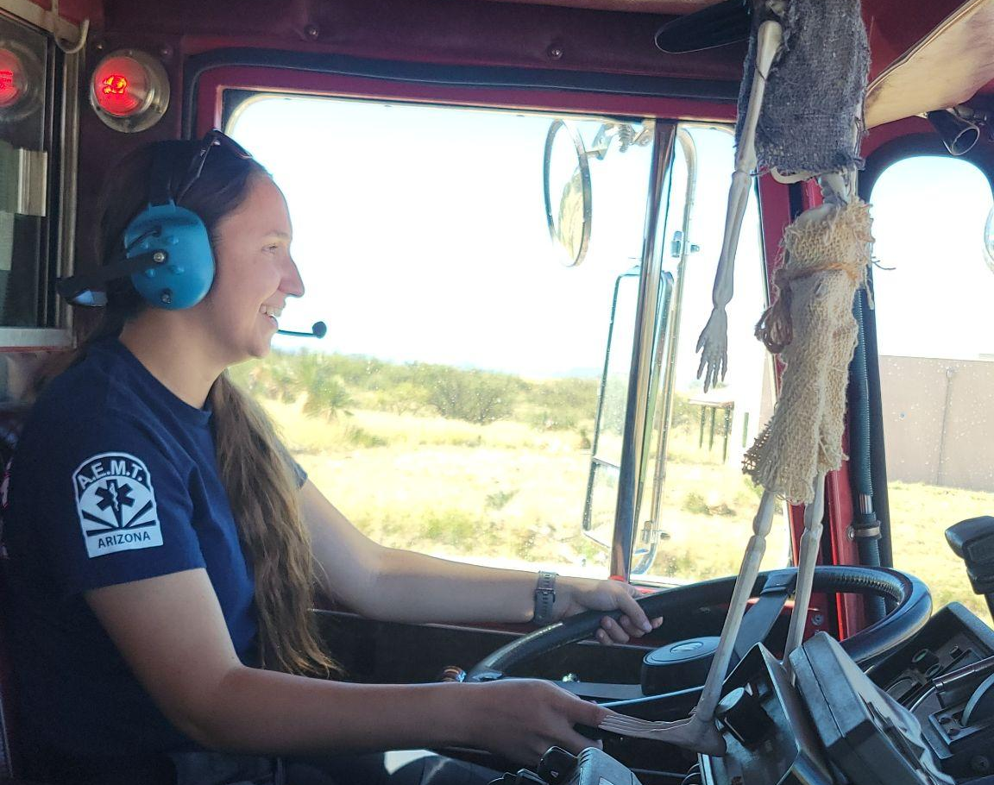
6B.5 Cancer Prevention Program
How’d we do? Cancer is the #1 killer of FF. This year, through a grant from Greater Tucson Fire Foundation, we received free cancer screenings for anyone over 40. 50% of us tested positive., but the silver lining is it appears to be caught fairly early.
Action Taken: We have moved our turnouts from the bay into a donated Conex box for storage, equipped with solar fans, eliminating the massive amount of diesel exhaust exposure.
We were also successful in procuring a turnout extractor, which better washes our FF gear and removes more carcinogens.

Slide 32
Questions?
Please feel free to ask any question that comes to mind.

